Slide 1
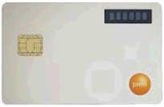
AGRONet Business Internet Banking
Change the “Login with your Secure Pass” to a “check box with Secure Pass wording”
To remove the picture or keep it?
Agrobank to provide and confirm the picture
Secure Pass
WELCOME
NEED HELP?
1 300 88 2476
Do you need to include the ATM operation hours information?
I WANT TO PERFORM
Enter your username
1st Time Login
Reset Password
Activate Secure Pass
Login
If needed the Agronet Demo,
it will be available for HTML format
To locate under the Activate Secure Pass
Enter your password
Internet Banking Operation Hours
4.00am – 12.00am
Banking Operation Hours
9.00am – 4.30pm
Login with your
Secure Pass
This is link to Agrobank facebook:https://www.facebook.com/Agrobank
DO NOT login via email link. Find out more.
It will available for 3 buttons
This is link to Agrobank twitter: pls provide the link

Slide 2
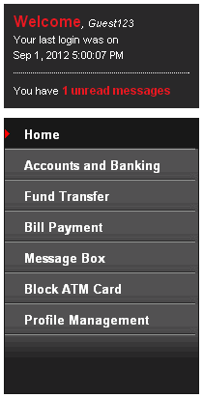
1. If no FD or Loan account. It will display blank but the Primary FD/Loan Account Balance Title will be shown.
2. Only display any 1 of the CASA/FD/Loan account.
Concern/Highlight:
Since this information require get from Host system, it will cause slowness respond issue and we can not assess now of the slowness respond time due to
we do not has the host integration format
no mock up data for testing
If this is required, a test need to carry out and the test environment (host integration , data) require to be similar to the actual system environment.
Suggestion:
To replace the Executive Summary by Company Information?
AGRONet Business Internet Banking
Display the Approver outstanding list.
Link to Authorization List
EXECUTIVE SUMMARY
Primary Account Balance
Agro Perdana – I | RM1,500,000.00
5
Authorization List
AGRONet TRANSACTION STATUS
Pending Approver
Click “More” button, it will display the detail information of the online Transaction history as per print receipt information and format.
Primary FD Account Balance
FRIA – I (KLMain) | RM 500,000.00
More
Your last 3 AGRONet Transaction
New 3rd Party Account Transfer | RM 1,500,000.00
Shaiful Azwan Adnan
Bulk Transfer | RM 750,000.00
Ref. No: BT2345678
eFD Placement | RM 750,000.00
Group Acc. Number: 5-1234-5678
Acc. Number: 5-9876-5432
More
Primary Financing (Loan) Account Balance
Hartani – I | RM 450,000.00
More
Click “More” button, it will link to Accounts and Banking page
More
This is just a Title without click to any link
LATEST PROMOTION | ANNOUNCEMENT
3.75% Fund for Food. Find out more. [HOT!]
Maximum is 3 items listed in this page.
The 4 items onward will be go to “More News & promotion”?
If only 2 items, the More News & promotion still display or disappear?
2.75% p.a for Agro Muda-i. Find out more.
This will link to Agrobank Home page OR more promotion/announcement items ?
Agrobank introduced VISA Debit Card-i. Find out more.
More news & promotion
NEED HELP?
1 300 88 2476
Another “Logout” button

