Slide 1
UPASS System Design

Slide 2
User Cross Application Access
User belong to the same organization is able to use the same username for different applications
User belong to different organization is able to use the same username for different applications
User does not belong to an organization can use the same username for different application which also support only non organization user

Slide 3
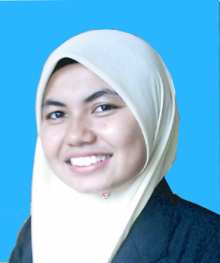
User Roles
Below defined roles will used for the scenario explanation later.
M2U User M2E User for TM | M2E User for TM Custody User for TM | M2E User for TM Custody User for Custody | M2E User for TM M2E User for Custody
Ali | Ateh | Siti | Sue

Slide 4
Scenario 1
Same user, different application
Ali has an account in M2U
Ali work for TM
TM has a M2E account
Ali is given the access to M2E
Ali’s username for M2U cannot be use for M2E
Ali must obtain one username for M2U and one for M2E

Slide 5
Scenario 2
Same user, same company and different application
Ateh work for TM
TM has a M2E account
TM also has an account at Custody
Ateh is given the access to M2E and Custody
Ateh can use the same username and password to access M2E and Custody

Slide 6
Scenario 3
Same user, different company and different application
Siti work for TM
Siti also work for Maxis
TM has a M2E account
Maxis has Custody account
Siti is given the access to M2E and Custody
Siti has one username for M2E
And has another username for Custody

Slide 7
Scenario 4
Same user, different company and same application
Sue work for TM
Sue also work for Maxis
TM has a M2E account
Maxis also has an account at M2E
Sue is given the access to M2E for both company
Sue has one M2E username for TM and has another M2E username for Maxis

Slide 8
Access Matrix explanation
Category
To categorize application
For example, ApplicationA’s user only has one role, ApplicationB’s user can belong to a company, ApplicationC’s use is belong to a module, etc..
One category can have multiple applications
Application
One application can have multiple roles
One application can have multiple Services
Role
A role in an application can have multiple Services
Organization
An organization can have multiple applications
An organization can have multiple users
User
One user can either belong to one Organization
Or not belong to any organization
Or self admin module
One user must belong one Category

Slide 9
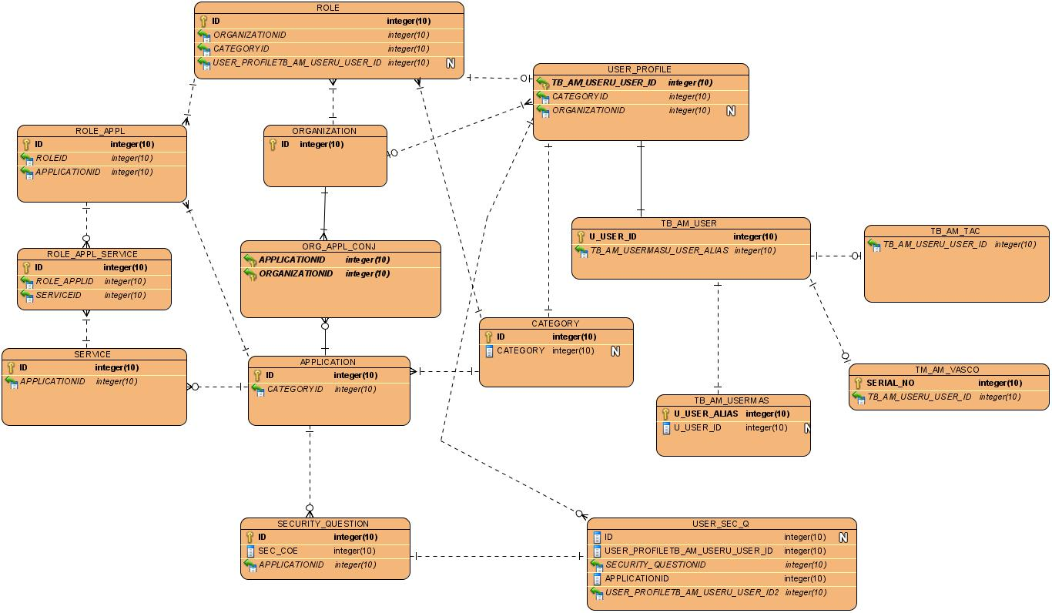
Table Design to cater for the above requirement

Slide 10
Security Question
Supported 2FA
Each application can have its own security question list
Each user can have its own set of security questions which bound to an application
TAC
Each user can have the most one TAC
Token
Each user can have at most one Token

Slide 11
Functionalities
System Login
System Admin
User Admin
DPX Upload
System Parameter Setting
Audit Log
Application Maintenance
Application User Maintenance
Role Maintenance

Slide 12
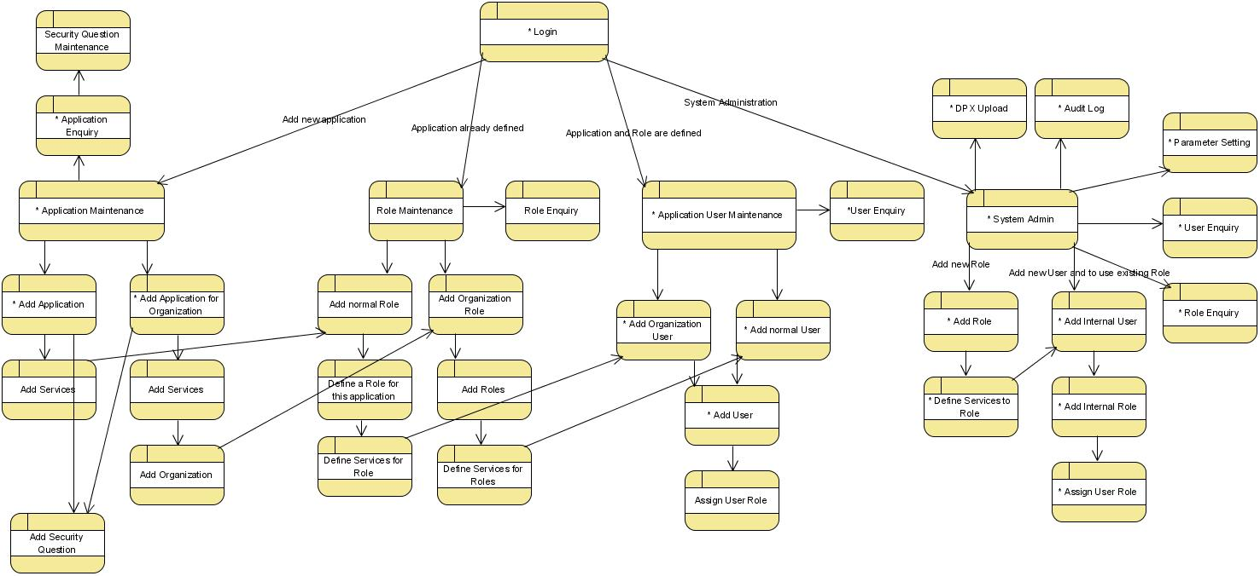
Functional and Page flows

