Slide 1
Preparation for Internet Banking Disaster Recovery (Dry Run)

Slide 2
DR Site Preparation
All networks equipments and servers are installed, setup and configured
All IBS applications are installed and configured
Complete SIT
Complete UAT

Slide 3
DR Preparation checklist
No | Component | Signoff by | Date | Remarks
1 | IBS Application |  |  | Pending to complete UAT
2 | Database | Tahir | Oct 2nd
3 | VERITAS NETBACKUP server | Adhamuddin | Sept 16th
4 | Firewalls , IPS |  |  | Pending IP Address Change
5 | Network , switch | Hazrul | Nov 9th
6 | Server Connectivity | Nurazri | Nov 2nd

Slide 4
Introduction

Slide 5
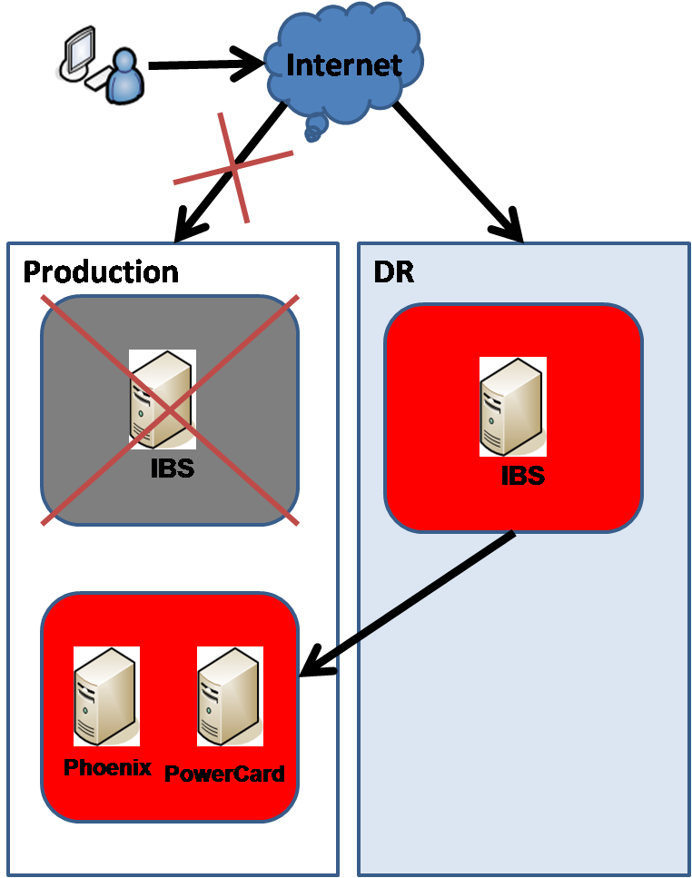
Scenario 1
Swing KFH Internet Banking System to DR site

Slide 6
Scenario 2
Swing Both KFH Internet Banking System and Phoenix to DR site
Internet
Production
DR
IBS
IBS
Phoenix
PowerCard
Phoenix

Slide 7
When Scenario 1 Is Declared

Slide 8
Scenario 1
Swing KFH Internet Banking System to DR site

Slide 9
Assumptions
DR site is ready
This is a cold (active/passive) DR site
All network equipment and servers are powered on
DR Internet Banking System Application and Database have been refreshed with latest updated programs and data
All responsible personnel has been informed

Slide 10
Scenario 1 - Checklist Overview

Slide 11
Scenario 1 - Checklist To Swing TO DR
Step | Activities | Responsible
1 | Startup All DR Internet Banking Application | IT App/IT Infra/IT Server
2 | Setup DR ESB to point to Production Phoenix at primary site | IT App/IT Infra
3 | DR Internet Banking Application Comfort Test | PDM / ICU / Service Channel / Call Centre
4 | Activate the process to swing www.kfhonline.com.my to DR site | IT Infra
5 | Open DR to public | IT Security

Slide 12
Scenario 1 - Detail Checklist

Slide 13
Scenario 1 - Startup All Internet Banking Applications
Step | Activities | Responsible
1 | Startup Oracle 10g Database – refer to “Start Up Oracle 10g Database” | IT App/DBA
2 | Startup AquaLogic ESB Application – refer to “Start Aqua Logic Service Bus (ALSB) and WebLogic Server” | IT Infra /IT Server
3 | Startup BroadVision Application – refer to “Start BroadVision 8.1 Service” | IT Infra /IT Server
4 | Startup Sun Java Webserver – refer to “Start Up SunOne Webserver” | IT Infra /IT Server
5 | Startup SMSCron (SMS Notification) – refer to “Start SMS Gateway Service” | IT Infra /IT Server

Slide 14
Scenario 1 - Setup ESB Point To Production Phoenix
Step | Activities | Responsible
1 | Change the JDBC DataSource configuration to point to Product Phoenix IP – “Refer to DR Scenario 1 - Modify JDBC DataSource in WebLogic Server.doc” | IT App/IT Infra
2 | Change the JDBC DataSource configuration to point to DR OC4J – “Refer to DR Scenario 1 - Modify JDBC DataSource in WebLogic Server.doc” | IT App/IT Infra

Slide 15
Scenario 1 - DR Comfort Test
No | Activities | Tested Destination | Responsible
1 | Forgot Username Test | PowerCard | PDM
2 | Login Test | Authentication | PDM
3 | Account Enquiry Test | Phoenix | PDM
4 | IB Transaction History Test | Database | PDM
5 | Request TAC Test | Macrokiosk | PDM
6 | Bill Payment Zakat Test | MobilityOne | PDM
7 | Mobile Reload Test | ePay | PDM
8 | Download eStatement | Shared Statement Folder | PDM
9 | Request for Hardcopy Statement | Mail Server | PDM
* Refer to “DR SCENARIO 1 APPLICATIONS ACCEPTANCE TEST SCRIPT”

Slide 16
Scenario 1 – DR BVMC Comfort Test
No | Activities | Test Destination | Responsible
1 | BVMC for Admin user Test | Database | ICU
2 | BVMC for Contact Centre Test | Database | Call Centre
3 | BVMC for Content Management Test | Database | Service Channel
4 | BVMC for Report Retrieval Test | Database/Shared Folder | PDM
5 | BVMC for IB Content Test | Database | PDM
6 | Forex Rate and Unit Trust shared folder access Test | Shared Folder | Service Channel
* Refer to “DR SCENARIO 1 APPLICATIONS ACCEPTANCE TEST SCRIPT”

Slide 17
Scenario 1 - Available Module

Slide 18
Scenario 1 - Available Internet Banking Modules
Account Enquiry
Transaction History
IB Transaction History
Download eStatement
Request for Hard Copy Statement
Own Account Transfer
3rd Party Transfer
FTT
GIA
Bill Payment
Mobile Reload
Cheque Management
Request for Cheque Book
New Account Application Form
Financing Application Form
Profile Maintenance
Registration
Forgot Password, Forgot Username, Forgot Security Question
Request TAC

Slide 19
Scenario 1 - Other Available Modules
BVMC for Call Center
BVMC for ICU
BVMC for PDM
BVMC for Content
BVMC for Reports Retrieval
Daily Report Generator
Monthly Report Generator
Forex Rates Updater
Unit Trust Rates Updater
Prayer Time Updater

Slide 20
Scenario 1 - Swing Back To Production

Slide 21
Scenario 1 - Assumptions
Production site is ready
All responsible personnel has been informed

Slide 22
Data Integrity During DR
Internet Banking possible data lost
The new data which resided on the production when DR is declared will not be able to copy to DR site. Manual work is needed to recover the data if possible.
All below data will be based on last production database backup plus new data from DR
IB Transaction History
Favorite Maintenance
Password
Profile
Mobile Number Reset
All data in BVMC
Information Side Content

Slide 23
Scenario 1 - Checklist To Swing Back To Production
Step | Activities | Responsible
1 | Stop All DR Internet Banking Applications and Backup DR Internet Banking Database | IT App / DBA
2 | Stop All Production Internet Banking Application | IT Infra / IT Server
3 | Restore Data to Production Internet Banking Database | IT App / DBA
4 | Startup All Production Internet Banking Application | IT Infra / IT Server
5 | Production Internet Banking Comfort Test | PDM / ICU / Service Channel / Call Centre
6 | Activate the process to swing www.kfhonline.com.my to Production site | IT Infra
7 | Open Production to public | IT Security

Slide 24
Scenario 1 – Swing Back To Production Detail Checklist

Slide 25
Scenario 1 – Stop All Production Internet Banking Applications
Step | Activities | Responsible
1 | Stop BroadVision Application – refer to “Stop BroadVision 8.1 Service” | IT Infra / IT Server
2 | Stop AquaLogic ESB Application – refer to “Stop Aqua Logic Service Bus (ALSB) and WebLogic Server” | IT Infra / IT Server

Slide 26
Scenario 1 - Startup All Production Internet Banking Applications
Step | Activities | Responsible
1 | Startup Oracle 10g Database – refer to “Start Up Oracle 10g Database” | IT App / DBA
2 | Startup AquaLogic ESB Application – refer to “Start Aqua Logic Service Bus (ALSB) and WebLogic Server” | IT Infra / IT Server
3 | Startup BroadVision Application – refer to “Start BroadVision 8.1 Service” | IT Infra / IT Server
4 | Startup Sun Java Webserver – refer to “Start Up SunOne Webserver” | IT Infra / IT Server
5 | Startup SMSCron (SMS Notification) – refer to “Start SMS Gateway Service” | IT Infra / IT Server

Slide 27
Scenario 1 – Production Comfort Test
No | Activities | Tested Destination | Responsible
1 | Forgot Username Test | PowerCard | PDM
2 | Login Test | Authentication | PDM
3 | Account Enquiry Test | Phoenix | PDM
4 | IB Transaction History Test | Database | PDM
5 | Request TAC Test | Macrokiosk | PDM
6 | Bill Payment Zakat Test | MobilityOne | PDM
7 | Mobile Reload Test | ePay | PDM
8 | Download eStatement | Shared Statement Folder | PDM
9 | Request for Hardcopy Statement | Mail Server | PDM
* Refer to “DR SCENARIO 1 PRODUCITON APPLICATIONS ACCEPTANCE TEST SCRIPT”

Slide 28
Scenario 1 – Production BVMC Comfort Test
No | Activities | Test Destination | Responsible
1 | BVMC for Admin user Test | Database | ICU
2 | BVMC for Contact Centre Test | Database | Call Centre
3 | BVMC for Content Management Test | Database | Service Channel
4 | BVMC for Report Retrieval Test | Database/Shared Folder | PDM
5 | BVMC for IB Content Test | Database | PDM
6 | Forex Rate and Unit Trust shared folder access Test | Shared Folder | Service Channel
* Refer to “DR SCENARIO 1 PRODUCITON APPLICATIONS ACCEPTANCE TEST SCRIPT”

Slide 29
When Scenario 2 Is Declared

Slide 30
Scenario 2
Swing Both KFH Internet Banking System and Phoenix to DR site
Internet
Production
DR
IBS
IBS
Phoenix
PowerCard
Phoenix

Slide 31
Scenario 2 - Assumptions
DR site is ready
This is the cold (active/passive) DR site
All networks equipments and servers are powered on
DR Internet Banking System Application and Database have been refreshed with latest updated program and data
Phoenix is also ready for DR
All responsible personnel has been informed

Slide 32
Scenario 2 - Checklist Overview

Slide 33
Scenario 2 - Checklist To Swing TO DR
Step | Activities | Responsible
1 | Startup All DR Internet Banking Application | IT App/IT Infra/IT Server
2 | Startup DR Phoenix | IT App
3 | Change DR ESB to point to DR Phoenix | IT App/IT Infra
4 | DR Internet Banking Application Comfort Test | UPDM / ICU / Service Channel / Call Centre
5 | Activate the process to swing www.kfhonline.com.my to DR site | IT Infra
6 | Open DR to public | IT Security

Slide 34
Scenario 2 - Detail Checklist

Slide 35
Scenario 2 - Startup All Internet Banking Applications
Step | Activities | Responsible
1 | Startup Oracle 10g Database – refer to “Start Up Oracle 10g Database” | IT App / DBA
2 | Startup AquaLogic ESB Application – refer to “Start Aqua Logic Service Bus (ALSB) and WebLogic Server” | IT Infra / IT Server
3 | Startup BroadVision Application – refer to “Start BroadVision 8.1 Service” | IT Infra / IT Server
4 | Startup Sun Java Webserver – refer to “Start Up SunOne Webserver” | IT Infra / IT Server
5 | Startup SMSCron (SMS Notification) – refer to “Start SMS Gateway Service” | IT Infra / IT Server

Slide 36
Setup ESB Point To DR Phoenix
Step | Activities | Responsible
1 | Change the JDBC DataSource configuration to point to DR Phoenix IP – Refer to “DR Scenario 2 - Modify JDBC DataSource in WebLogic Server” | IT Infra / IT Server

Slide 37
Scenario 2 – IB Comfort Test
No | Activities | Tested Destination | Responsible
1 | Forgot Username Test | PowerCard | PDM
2 | Login Test | Authentication | PDM
3 | Account Enquiry Test | Phoenix | PDM
4 | IB Transaction History Test | Database | PDM
5 | Request TAC Test | Macrokiosk | PDM
6 | Bill Payment Zakat Test | MobilityOne | PDM
7 | Mobile Reload Test | ePay | PDM
8 | Download eStatement | Shared Statement Folder | PDM
9 | Request for Hardcopy Statement | Mail Server | PDM
* Refer to “DR SCENARIO 2 DR APPLICATIONS ACCEPTANCE TEST SCRIPT”

Slide 38
Scenario 2 – BVMC Comfort Test
No | Activities | Test Destination | Responsible
1 | BVMC for Admin user Test | Database | ICU
2 | BVMC for Contact Centre Test | Database | Call Centre
3 | BVMC for Content Management Test | Database | Service Channel
4 | BVMC for Report Retrieval Test | Database/Shared Folder | PDM
5 | BVMC for IB Content Test | Database | PDM
6 | Forex Rate and Unit Trust shared folder access Test | Shared Folder | Service Channel
* Refer to “DR SCENARIO 2 DR APPLICATIONS ACCEPTANCE TEST SCRIPT”

Slide 39
Scenario 2 - Available Module

Slide 40
Scenario 2 - Available Internet Banking Modules
Account Enquiry
Transaction History
IB Transaction History
Download eStatement
Request for Hard Copy Statement
Own Account Transfer
3rd Party Transfer
FTT
GIA
Bill Payment
Mobile Reload
Cheque Management
Request for Cheque Book
New Account Application Form
Financing Application Form
Profile Maintenance
Request TAC

Slide 41
Other Available Modules
BVMC for Call Center
BVMC for ICU
BVMC for PDM
BVMC for Content
BVMC for Reports Retrieval
Daily Report Generator
Monthly Report Generator
Forex Rates Updater
Unit Trust Rates Updater
Prayer Time Updater

Slide 42
Scenario 2 - Not Available Internet Banking Module
Registration
Forgot Password, Forgot Username, Forgot Security Question

Slide 43
Scenario 2 - Swing Back To Production

Slide 44
Scenario 2 - Assumptions
Production site is ready
All responsible personnel has been informed

Slide 45
Scenario 2 - Checklist To Swing Back To Production
Step | Activities | Responsible
1 | Stop All DR Internet Banking Applications and Backup DR Internet Banking Database | IT App / DBA
2 | Stop All Production Internet Banking Application | IT Infra / IT Server
3 | Restore Data to Production Internet Banking Database | IT App / DBA
4 | Startup All Production Internet Banking Application | IT Infra / IT Server
5 | Production Internet Banking Comfort Test | PDM / ICU / Service Channel / Call Centre
6 | Activate the process to swing www.kfhonline.com.my to Production site | IT Infra
7 | Open Production to public | IT Security

Slide 46
Scenario 2 – Swing Back To Production Detailed Checklist

Slide 47
Scenario 1 – Stop All Internet Banking Applications
Step | Activities | Responsible
1 | Stop BroadVision Application – refer to “Stop BroadVision 8.1 Service” | IT Infra / IT Server
2 | Stop AquaLogic ESB Application – refer to “Stop Aqua Logic Service Bus (ALSB) and WebLogic Server” | IT Infra / IT Server

Slide 48
Scenario 1 - Startup All Internet Banking Applications
Step | Activities | Responsible
1 | Startup Oracle 10g Database – refer to “Start Up Oracle 10g Database” | IT App / DBA
2 | Startup AquaLogic ESB Application – refer to “Start Aqua Logic Service Bus (ALSB) and WebLogic Server” | IT Infra / IT Server
3 | Startup BroadVision Application – refer to “Start BroadVision 8.1 Service” | IT Infra / IT Server
4 | Startup Sun Java Webserver – refer to “Start Up SunOne Webserver” | IT Infra / IT Server
5 | Startup SMSCron (SMS Notification) – refer to “Start SMS Gateway Service” | IT Infra / IT Server

Slide 49
Scenario 2 – Production Comfort Test
No | Activities | Tested Destination | Responsible
1 | Forgot Username Test | PowerCard | PDM
2 | Login Test | Authentication | PDM
3 | Account Enquiry Test | Phoenix | PDM
4 | IB Transaction History Test | Database | PDM
5 | Request TAC Test | Macrokiosk | PDM
6 | Bill Payment Zakat Test | MobilityOne | PDM
7 | Mobile Reload Test | ePay | PDM
8 | Download eStatement | Shared Statement Folder | PDM
9 | Request for Hardcopy Statement | Mail Server | PDM
* Refer to “DR SCENARIO 2 PRODUCITON APPLICATIONS ACCEPTANCE TEST SCRIPT”

Slide 50
Scenario 2 – Production BVMC Comfort Test
No | Activities | Test Destination | Responsible
1 | BVMC for Admin user Test | Database | ICU
2 | BVMC for Contact Centre Test | Database | Contact Centre
3 | BVMC for Content Management Test | Database | Service Channel
4 | BVMC for Report Retrieval Test | Database/Shared Folder | PDM
5 | BVMC for IB Content Test | Database | PDM
6 | Forex Rate and Unit Trust shared folder access Test | Shared Folder | Service Channel
* Refer to “DR SCENARIO 2 PRODUCITON APPLICATIONS ACCEPTANCE TEST SCRIPT”

Slide 51
Thank You

